Slide 1
Target aims to strengthen its platform by building new XX solution along with upgrading and integrating multiple capabilities in 2023
Business management
roadmap
Roadmap
2020-2023 roadmap
Commentary
Q1’ 23
Q2’ 23
Q3’ 23
Q4’ 23
Innovation
Launched unified platform in late 2021. Now in 2023 advancing to build XX solution on the same unified platform
Target’s platform introduced first MSP PaaS solution in 2022
Plan for additional offering of New platform ticketing and service in 2023
Upgradation
During 2023, Target plans to upgrade almost all its capabilities under XX solution - Manage (PSA), Sell (CPQ), Service Leadership and Sync (Payments) etc.
Acquisitions
After acquiring multiple companies in years 2020-2022 (IT Boost, Service Leadership and Sync), Target in 2023 is aiming to integrate all the services offered by those players into its own eco-system
Innovation
`
New XX solution built on platform
Asio PaaS extended to support XX and revenue share with ecosystem
Maintenance
& Upgradation
Manage ML ticket Sentiment analysis
PSA – Microsoft 365 contact sync
Reimagined – Product catalogue w/vendor
Reimagined – Quoting CPQ
Reimagined – Projects PSA
Reimagined – Projects PSA
Reimagined – Procurement PSA
CPQ – Performance improvements
Reimagined – Projects PSA
Reimagined – Procurement PSA
Reimagined – Service Leadership Index
Reimagined – Service Leadership Index
Reimagined – Ticketing PSA
Reimagined – Service Leadership Index
Reimagined – Ticketing PSA
Reimagined – Contract PSA
Reimagined – Contract PSA
New Integration
Wise-Pay for PSA
Wise-Sync- Dashboards & Onboarding
BrightGauge — Near Realtime Dashboard
Wise-Sync- Dashboards & Onboarding
Project Surveys - SmileBack
ITBoost — One-Time-Password
Arrow electronic ordering in CPQ
Source: Project Target; Bain Analysis

Slide 2



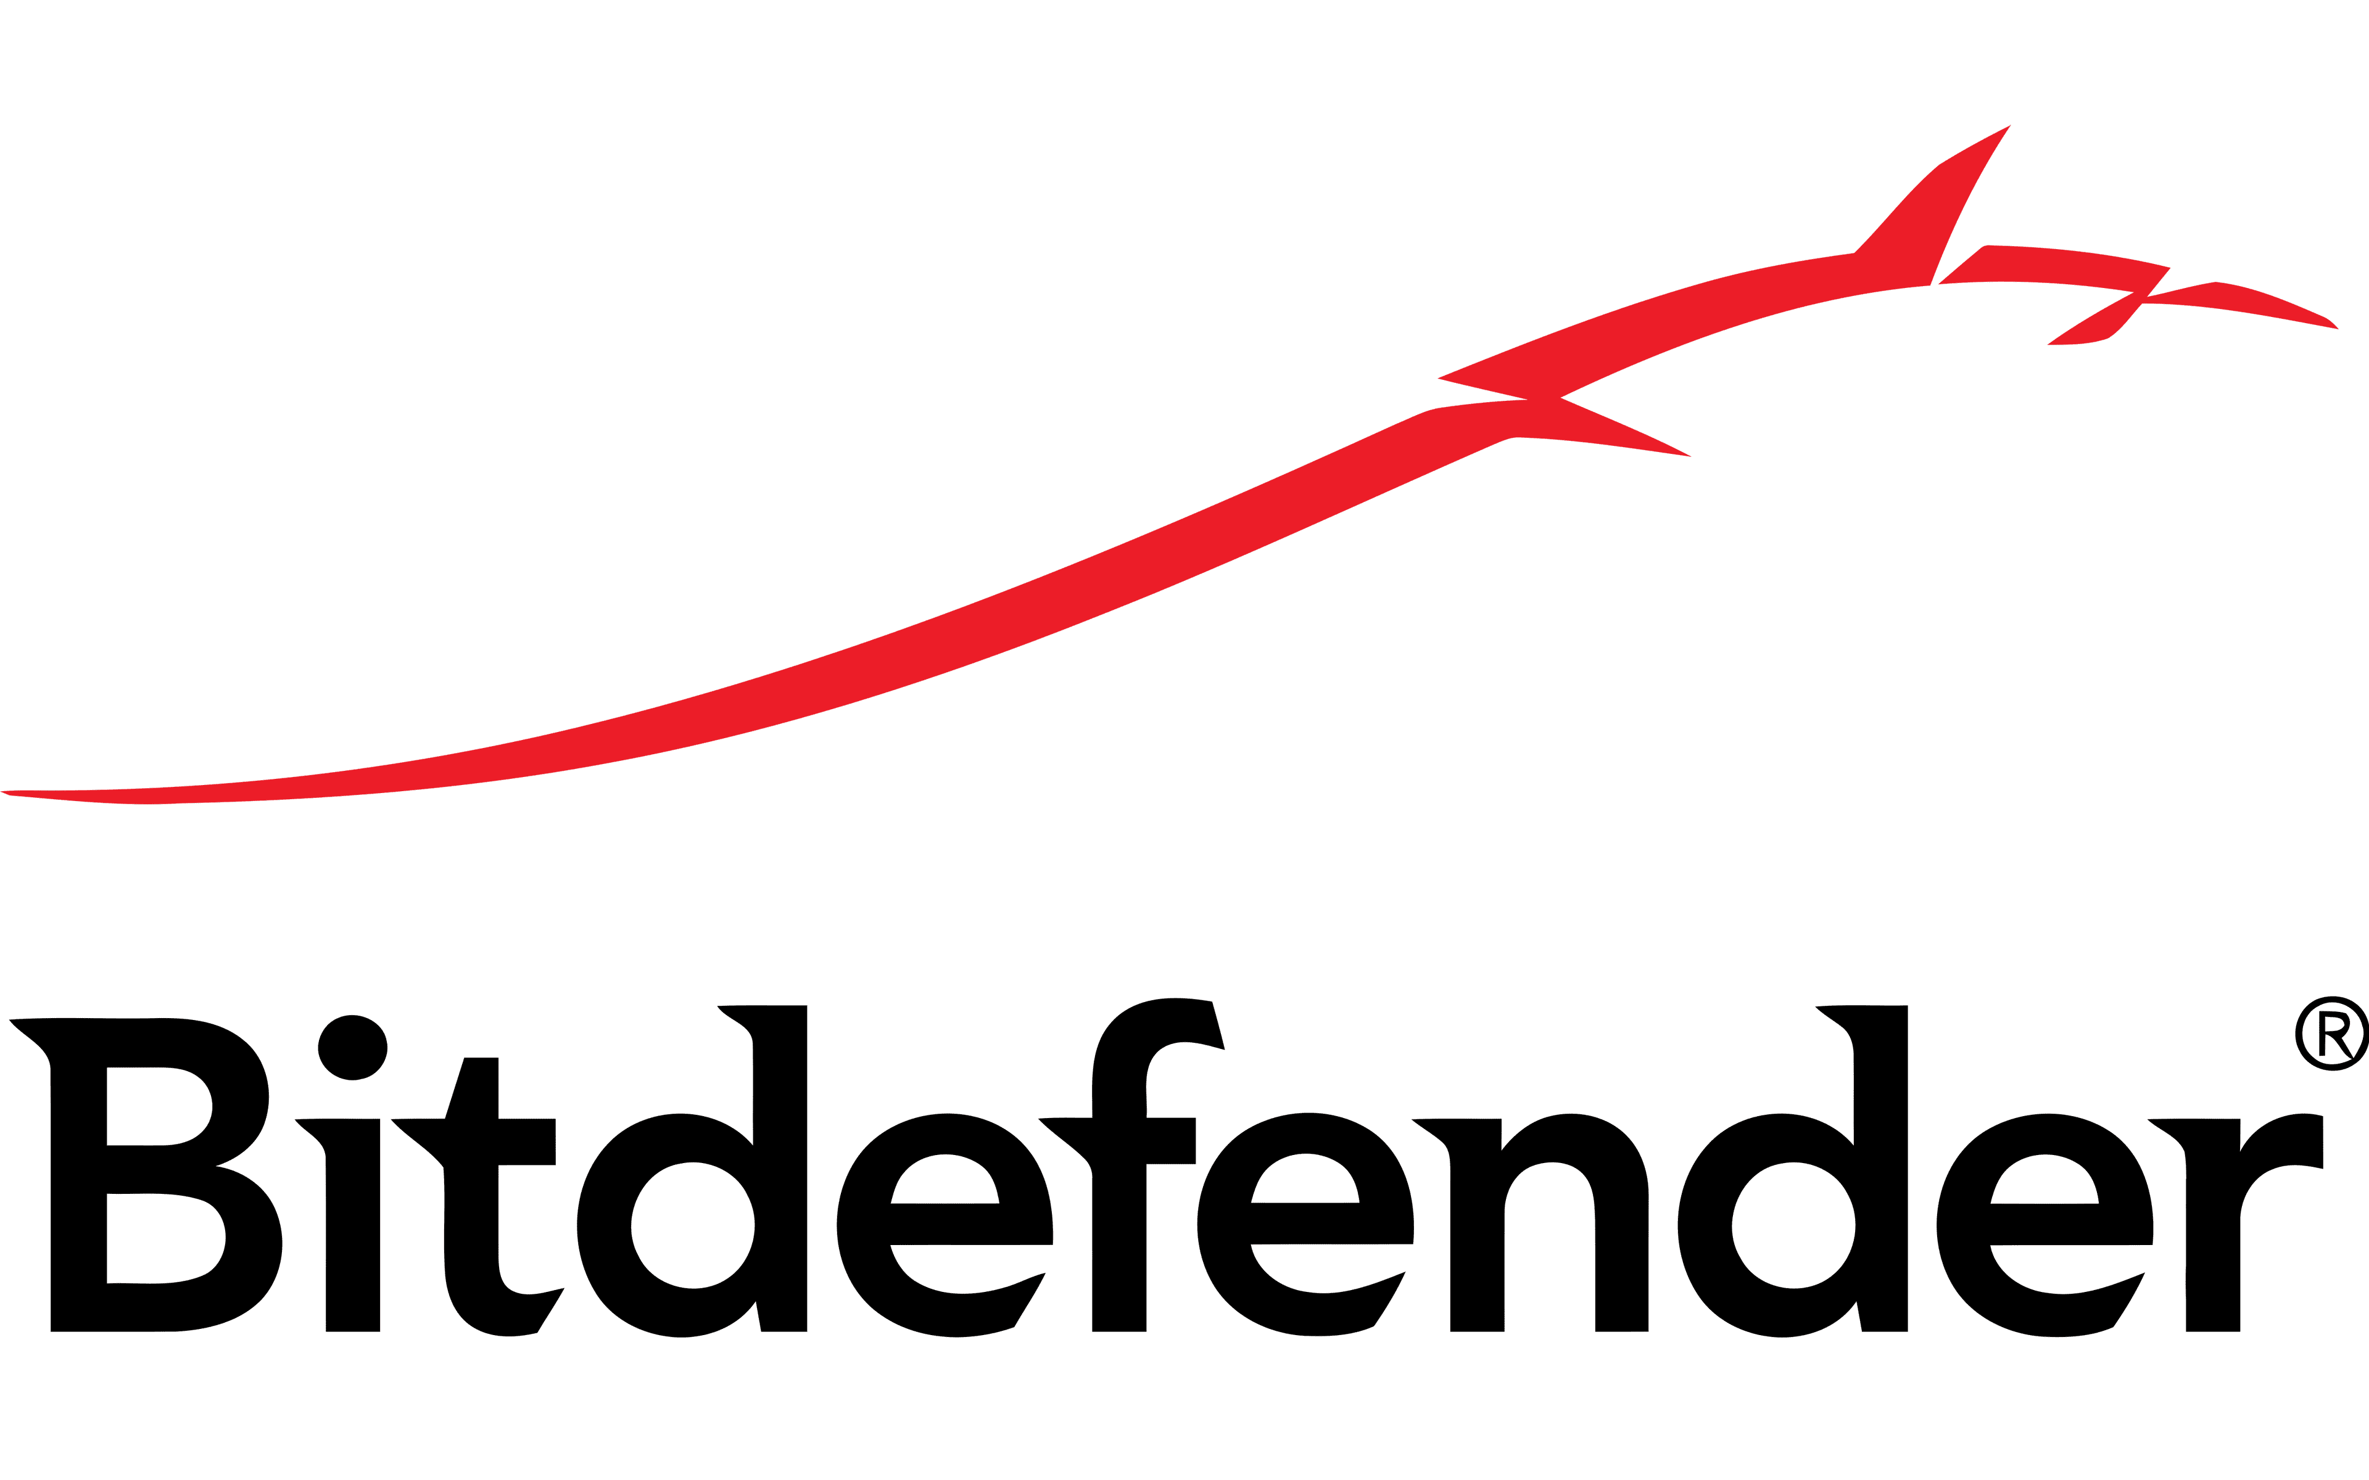









Unlike most of its peers, Target has formed partnerships with third-party vendors across broad range of cybersecurity products and services
Cybersecurity
Vendor Offerings
Competitive Benchmarking
Vendors’ inhouse IP vs. leveraged 3rd party software
3rd party software
Inhouse IP
No offering
Via acquisition
 | Products |  |  |  |  |  |  | Services
OTS software leveraged | SIEM | EDR/MDR | Cloud app security | Vulnerability management | Identity management | Endpoint policy management | Secure access | SOC | Incident response
Target
Offers via partnering with Carbonite, under its same parent company
Source: Project Target; Bain Analysis

Slide 3
UI/UX: [Target] performs good overall, especially on products & solutions pages; [comp] also has a good interface (1/2)
overall_0_132251922399889533 columns_7_132251921367496985 4_0_132251922393368237 5_1_132251921972023876 9_1_132251922332107745 16_0_132251923688171413 17_0_132251923672171478
website
User experience
Better than peers Similar to peers Lagging peers
UI / UX
Metric
Page load time | 11.6s | 3.5s | 14.7s | 3.2s | 3.5s | 7.2s
Home page | Clean & well-designed layout with use of pictures; well-organized with brand messaging and offerings | Short page with limited information; pictures used; brand messaging and offerings present | Well-designed page with good use of pictures & icons; well organized with brand messaging and offerings | Well-structured short page; limited use of pictures with more focus on product graphics; brand messaging and offerings present | Well-structured page; pictures used but are of low quality; brand messaging and offerings present | Well laid-out, but short page; limited use of pictures; limited brand messaging; offerings mentioned
Main Menu | Standard hoverable menu bar with category information and icons; lack of sub-menu options and images | Standard menu ribbon; limited sub-menu options and menu not hoverable | Standard menu bar; sub-menus available, but no details and icons; menu hoverable | Comprehensive menu bar; sub-menu available, but no details or icons; menu hoverable | Standard menu bar; sub-menus available, but no details and icons; menu hoverable | Comprehensive menu bar with graphics and extensive categorization present in sub-menu; menu hoverable
Master Search | Available but is not predictive | Not available | Predictive search available | Available but is not predictive | Available but is not predictive | Predictive search available
Ease of booking a demo | Option available on the top-right of the home page; form requires just the basic details | Option available on the top-right of the home page; form requires additional details like company size | Option not available directly on the homepage; accessible through ‘contact us’ page, form requires basic details | No demo-request option (can contact sales team through a form on contact us page) | Demo-request option not present on home page; accessible through solutions pages and requires basic details | Option available on the top-right of the home page; form requires additional details like company revenue
Products & solutions layout | Well laid-out, easy-to-follow solutions page with a clean design; provides short descriptions, links to learn more or book demo, value propositions present; customer team names mentioned with photos | Well laid-out, easy-to-follow solutions page with a clean design; provides short descriptions, links to learn more and a common link to book demo | Well laid-out page with scrollable menu and collapsible topics; verbose descriptions, links to learn more and a common link to book demo | Short page with limited overview on solutions & products; value proposition mentioned | Well laid-out, detailed, and easy-to-follow solutions page with a clean design; provides short descriptions, links to learn more present | No overall solutions overview page available; on solutions pages by business need, information is well laid-out with links to explore products; no direct link to book demo
Arrival
1
2
Search & Navigation
3
4
Products & Solutions
5
6
Note: Page load time determined on webpagetest.org with test location in Virginia and connection set to FIOS (20/5 Mbps) | Source: Company websites as on 9th Sep’21, Bain Analysis

Slide 4
Target has a sizable R&D organization totaling 127 FTEs and ~50 contractors; recent hiring strategies have increased amount of both remote and offshore resources
R&D team and process
Organization CHART
Organization Chart
Target R&D organization
Key takeaways
Total R&D resources: 127 FTEs (and ~50 offshore FTEs)
~135 FTEs
Target's technology organization consists of cross-functional teams, comprised of product engineering and QA, which report to the CPTO
Target is primarily based in the US, with nine resources located in Canada. While most resources are in-house, Target outsources certain functions, particularly software engineering and QA
In recent years, Target has invested in scaling its organization by expanding the offshore FTE count and increased utilization of remote employees. The R&D organization consists of ~40% remote and offshore FTEs with the remaining 60% in-person/hybrid in Tampa, FL
Within the past 2 years, Target has hired remote FTEs from the US and Canada. Greater adoption of remote workers allows Target to access more experienced talent
The company has ~135 resources dedicated to the Support and Implementation teams, primarily consisting of Product Support Specialists, Project Managers/Specialists, and Implementation Specialists
The Implementation team is responsible for customer migrations
Implementation team ~40 FTEs
Target has 2 open roles within its R&D organization: Senior Director - Product, and Director - Quality Assurance
Support team ~95 FTEs
CTO / CPO
Product mgmt. (30)
Software development (65)
Quality assurance (18)
Tech ops (14)
SVP, Product Management
SVP, Software Development
VP, Software Development
Director, Quality
Director, Tech Ops
Market R&D
Software Engineers
Software Engineers
Quality Analysts
Cloud Services
Target Solutions
Software Eng., Test
Application Security
Product Operations
Data Service
Customer Excellence
“The people that work there now, they have an outstanding understanding of what their market is, what their solution is, and who their clients are. So, you have people there that are deeply expert in those areas. They are really dedicated, you'll see a lot of long tenure in the people that are on staff there. And so, the knowledge is there.”
Former Executive #4, Target
Note: CTO- Chief Technology Officer, CPO- Chief Product Officer
Source: Target VDD deck; Target disclosure; Bain analysis

Slide 5
Internal team: A majority of Target’s R&D organization is based in the US (93%), with recent hiring in Canada (~7% of headcount)
R&D team and process
Geography and tenure split
R&D-Tenure & Geography
Geography split by R&D roles
Key takeaways
As expected, majority of Target’s total R&D headcount is dedicated to Engineering (~52%), Product (~16%), and QA roles (~14%)
Most of the R&D FTEs are in the US, with a growing presence in Canada (~7% of R&D FTEs) due to recent hiring, including 4 leadership roles
Target’s R&D team has an average tenure of 6.2 years. ~44% of the team has been in the company for more than 5 years
Six out of the thirteen current R&D leaders (4 Directors, 1 SVP - Product Management, and the CTPO) were hired within the past 14 months
Target’s tech team has a balanced Developer to QA ratio whereas Developer to PM / Leadership ratios are slightly low (Target has more PMs/ leadership than expected)
Developers include 7 Team Managers and 3 Senior Managers
Product management includes 8 Product Analysts along with Product Managers
Tenure split by R&D roles
 | Dev. to QA | Dev. to PM¹ | Dev. to Leadership²
Overall | 3.9 | 5.1 | 5.1
US | 3.8 | 4.9 | 7.1
Canada | - | - | 0.5
Note: 1) Ratio based on PMs (excludes Product Analysts) 2) Leadership includes C suite, Directors and VPs; Others include two Application Support Analysts
Source: Target disclosure; Bain analysis

Slide 6








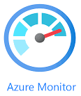








Target uses industry-standard agile scrum SDLC methodologies with adequate tooling deployed at each stage
R&D team and process
sdlc
Assessment:
Negative
Positive
SDLC
Business planning
Development
Testing and
quality assurance
Deployment
Maintenance and
monitoring
Weekly stakeholder roundtable discussions use the RICE (Reach, Impact, Confidence, Effort) framework to rank development initiatives and prioritize backlog items
High priority items are further elaborated in workstream management tools (Jira) to include functional acceptance criteria and testing requirements
Quarterly roundtable meetings involving R&D and product leadership are held to discuss roadmap priorities
Agile scrum methodologies are used in development, with 2-week sprints and agile ceremonies (daily stand-up meetings, retrospectives, planning sessions)
Code peer review and product manager signoff verify adherence to the predefined functional criteria
Maintenance items are incorporated into sprints
Developer-written automated test suites and static code scans are run and enforced in development tooling (i.e., GitHub, Azure DevOps)
Functional test code converge varies by product. Average coverage is 75-80% which reduces the need for manual testing, and is in line with industry standards
Load testing is performed using JMeter up to 3-5x current demand
Target uses automated service-based deployment in Azure via Azure DevOps
Typically, deployments are released to production every 2 weeks
Manual release gates include sign off by development/QA and approval by R&D/ product leadership
Features can be toggled on/off (using LaunchDarkly)
If critical defects are found after release, Target has a “fix forward” strategy to fix defects quickly instead of rolling back the entire release
Defect KPIs are tracked to identify root causes of issues
The environment is monitored using tools such as Azure Monitor, Logic Monitor, SQL Sentry, and Azure Application Insights
Expert commentary
SDLC process maturity
“We documented the processes, we have clarity around the vocabulary that we use, we have standard ceremonies. I think the experience I've had so far has been pretty good.”
Former Executive #2, Target
“It's pretty Scrum-based. So you have the standard ceremonies across those teams. Backlog, grooming, planning sprints, 2- week sprints, sprint reviews, sprint retros. So all the ceremonies. We did try to empower the teams to work completely by themselves. They have a product manager assigned to the team, developers, and DevOps part of the team.”
Former Executive #3, Target
-
+
Source: Target VDD deck; Market participant interviews

Slide 7
Target has multiple applications in each architecture layer without proper integration; Different frameworks, versions, and languages are used across modules
A
B
Target
Tech architecture
Tech Architecture
Preliminary
Architecture diagram and tech stack
Key takeaways
1
Front End
2
Back End
5
Data/Storage/Services
For order-related tasks such as viewing status, submitting orders, and creating new SKUs, customers use B230, and for accessing invoices, they use AmTrans. Due to insufficient information, Bain cannot evaluate the technology and architecture of such portals that are directly facing the clients
Target is managing their warehouse operations utilizing the B230, CORE, and High Jump WMSs. Management was aiming to move all High Jump accounts to B230 by Jan’23 and all CORE accounts by the end of 2023. At the time of diligence meetings, A8 confirmed the timelines have been extended
B230 and STrak are desktop applications built on a .NET architecture, and their internal user Middleware application is web-based. However, the variety of .NET versions potentially adds to the technical debt leading to security risks and maintainability concerns
AmTrans, being a third-party app, poses operational risks as Target lacks ownership or the ability to make changes, and connects directly to B230 production database, which may require future maintenance work
For each warehouse, B230 operations depend on their own transactional database, with batch updates being sent to a central consolidated database. However, the organization is moving towards a consolidated database strategy, which is expected to streamline data flow and minimize technical debt.
For data management, Target relies on MS SQL 2008 (which reached end of life in 2019), exposing the company to extended outages and security risks
1
B230
B230 Desktop Application
1
B230 Facility DBs (x12)
2
CORE
B230 Main DB
3
Client Portal
High Jump
AmTrans DB
4
4
AmTrans
Languages
Languages
4
Services
5
Javascript
C#
Java
C#
SQL Server
6
4
3
Frameworks
Frameworks
Languages/Frameworks
Angular
.NET
SQL
Devices
Infrastructure
Infrastructure
6
Web application
Windows desktop
Flexential Colocation Datacenter
Flexential Colocation Datacenter
Legend
To-be phased out and migrated to B230 in 2023
WMS platforms
Third-party application
Source: RSM - Project Pace IT and Cyber DD reports

Slide 8






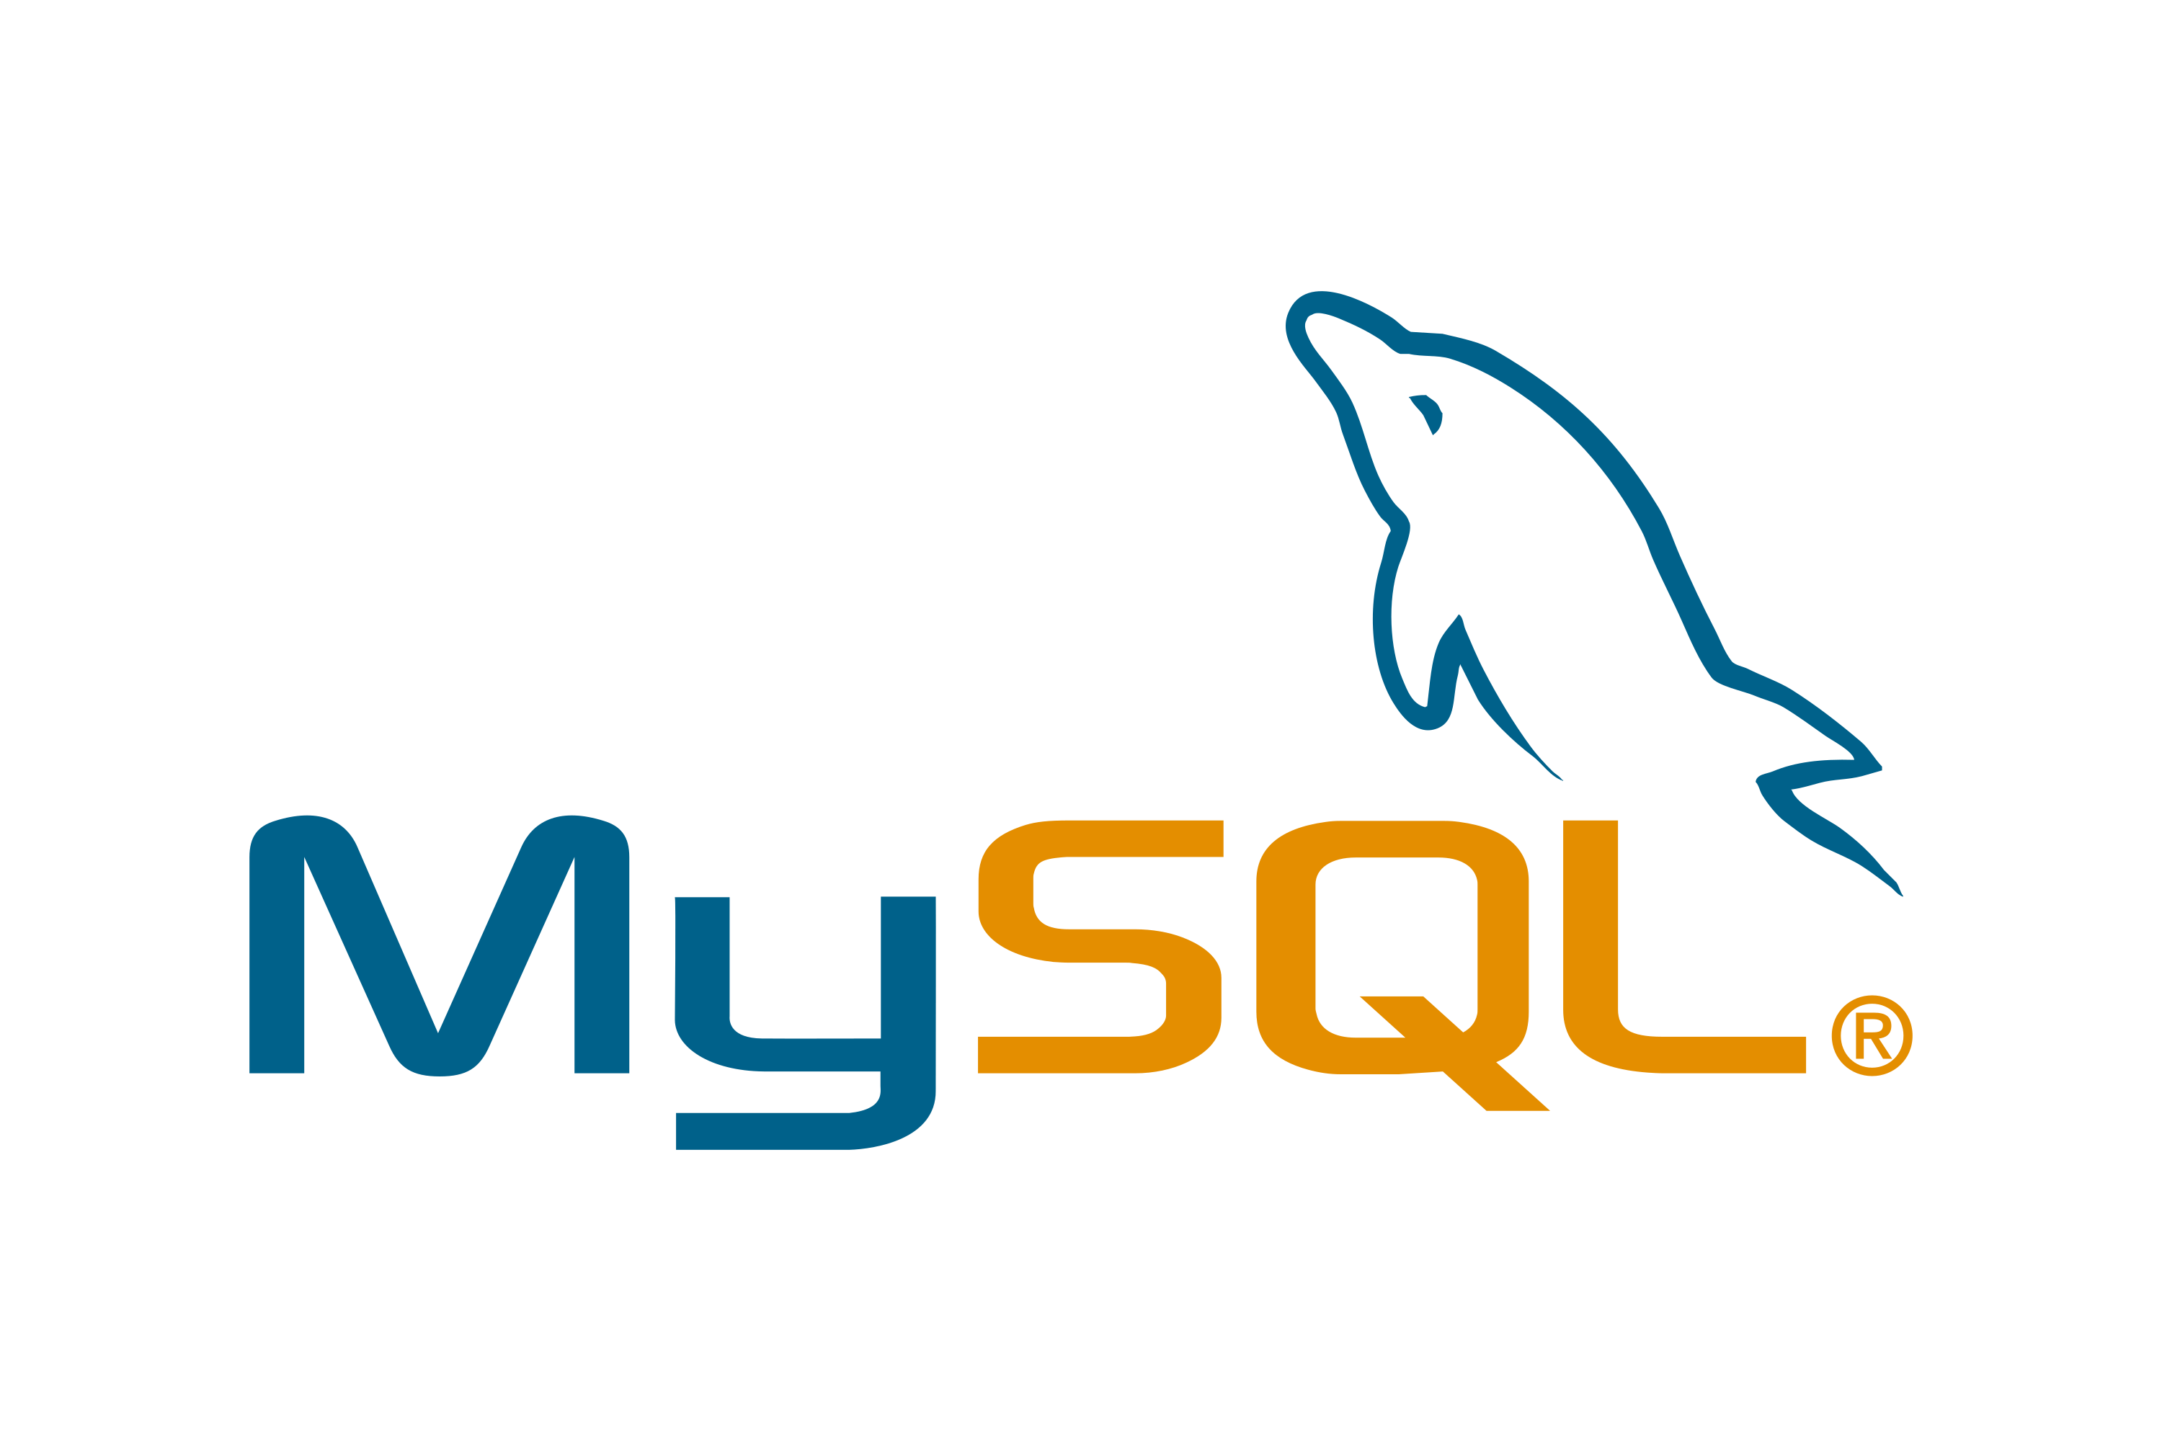

Target leverages older, well-established tech such as the C++ MFC framework; which may present a maintainability risk
Technology & Architecture
Technology stack
Tech Stack
Application |  |  | Description | Assessment
 | Frontend Technologies |  | C++ is an older, but well established and maintainable, programming language While still used for certain UI applications where speed of execution is important, it is an older frontend choice for this type of application Target is using BCGSoft to refresh the UI of its desktop tools; BCGSoft is a UI wrapper that can be used on top of C++ MFC applications, such as Versasec’s CMS While BCGSoft may provide a somewhat more modern UX, the UI will still appear relatively dated compared to industry standards | Target uses well established technologies that do not present an immediate maintainability risk; however, the age of these technologies results in a more dated UI/UX, which compares poorly with modern interfaces
 | Backend Technologies |  | C++ is an older, but well established and maintainable, general-purpose programming language; sourcing C++ developers in the next 5+ years may become increasingly challenging Target leverages the .NET framework. The company plans to migrate to .NET Core, which is the most modern iteration of the framework Newer modules with business logic have been written in C#, a very widely adopted programming language for developing .NET applications
 | Database Technologies |  | Target is provided with SQLite, a fast and simple database, as the default internal database Target also supports MariaDB, MySQL and MS SQL as external databases; these are relatively older but well-established databases that do not present maintainability risks
-
+
Assessment
Negative
Positive

